Slide 1
EcoSync
VANGA_BOYZ
CODE SAMURAI 2024

Slide 2
Contents
Landing Page

Slide 3
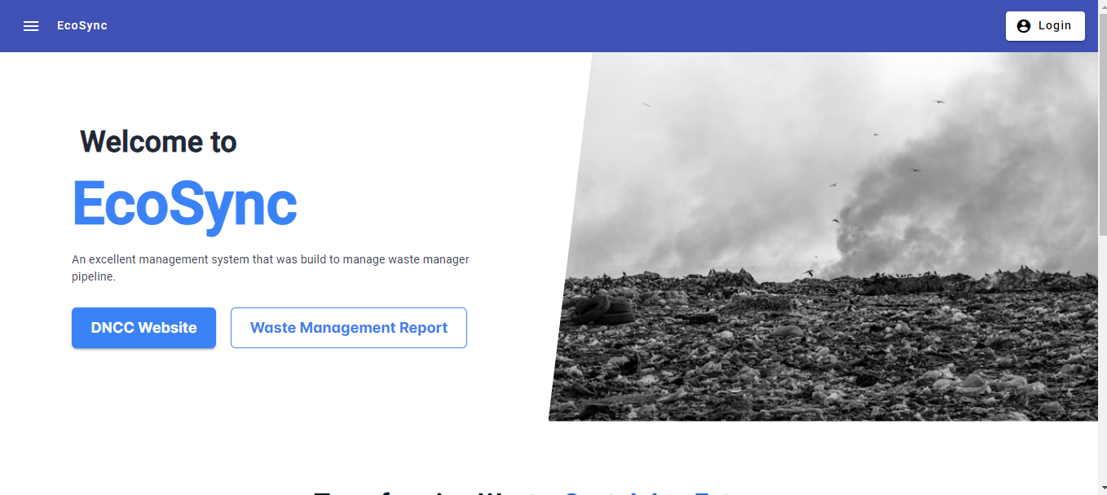
Landing Page

Slide 4
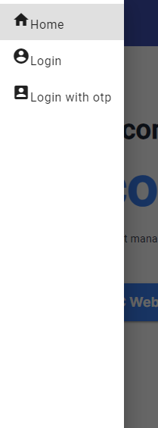
Side navbar without Login

Slide 5
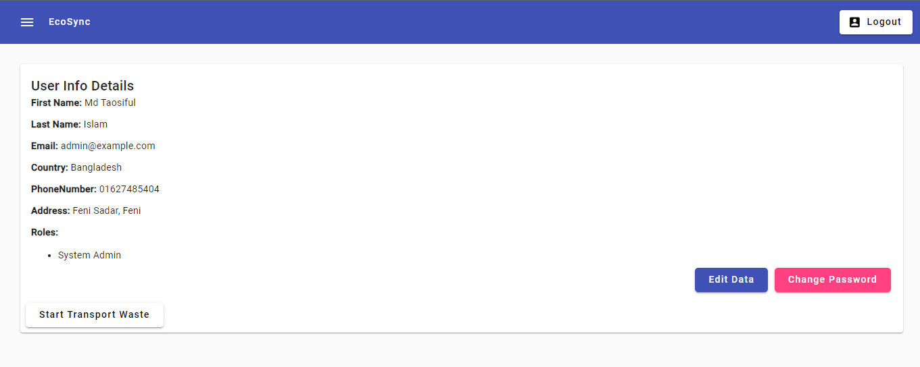
Profile Page

Slide 6
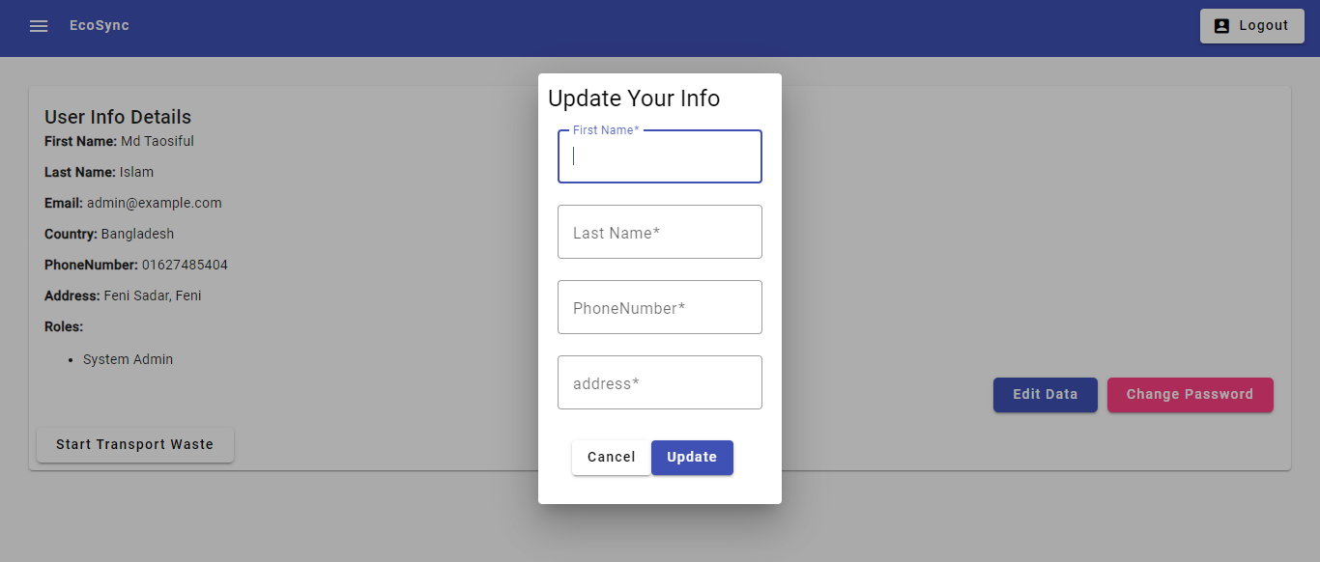
Update User Data

Slide 7
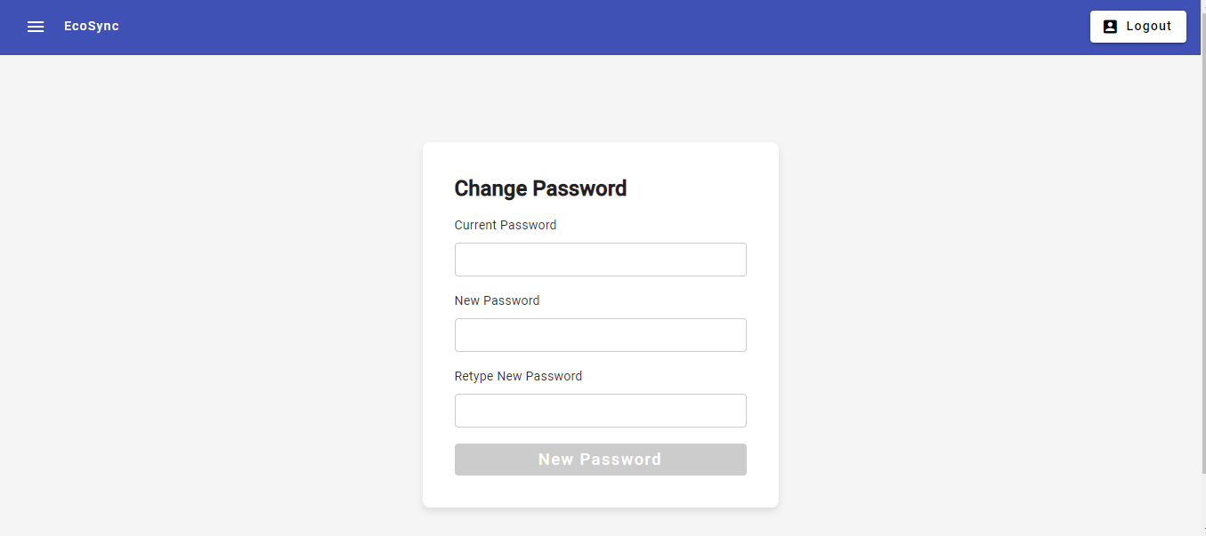
Change Password

Slide 8
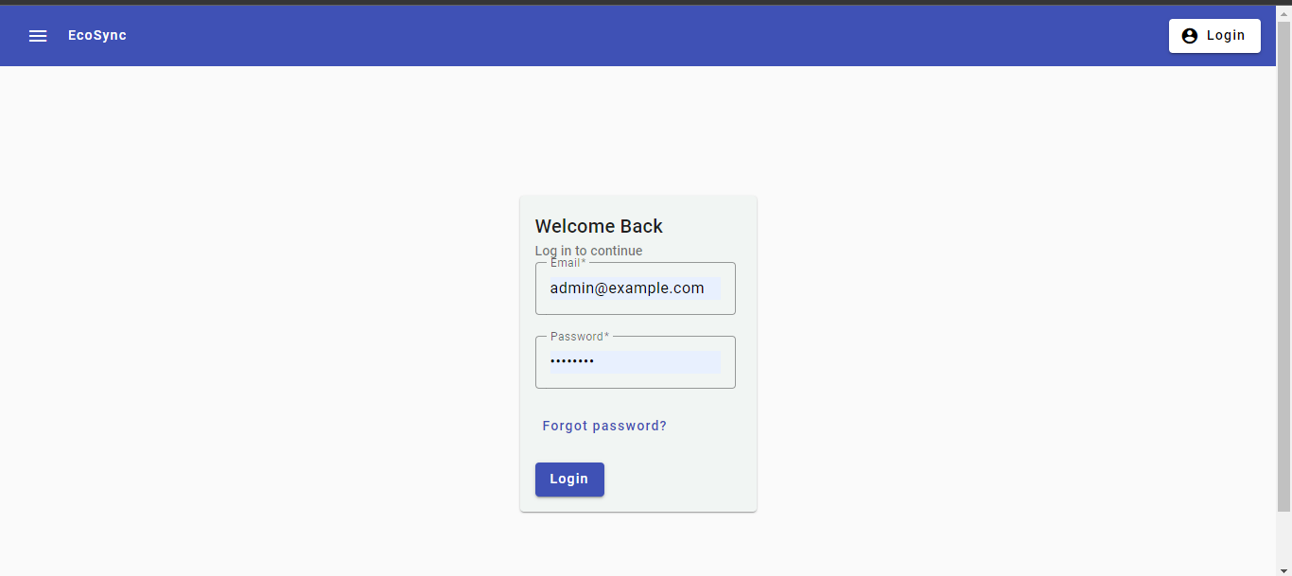
Login Page

Slide 9
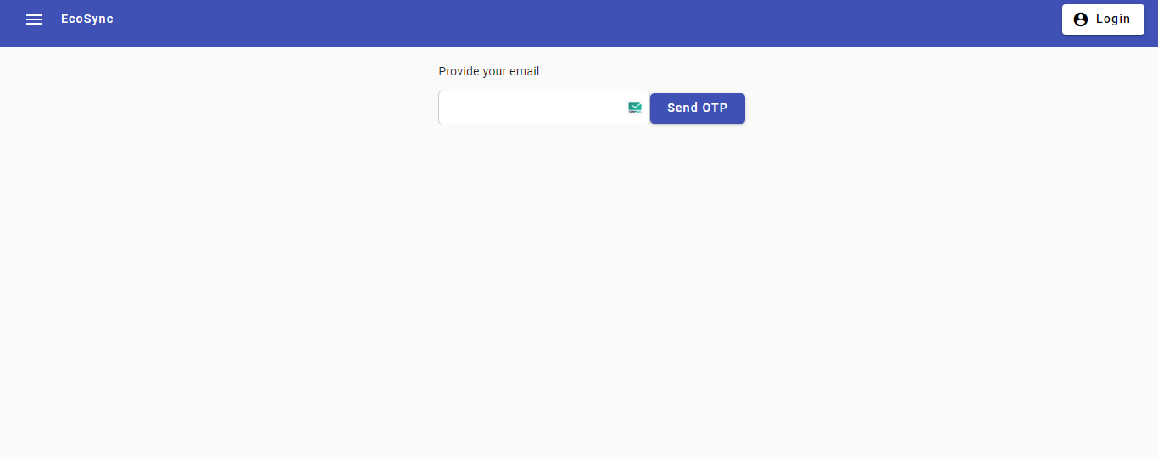
Forget Password

Slide 10
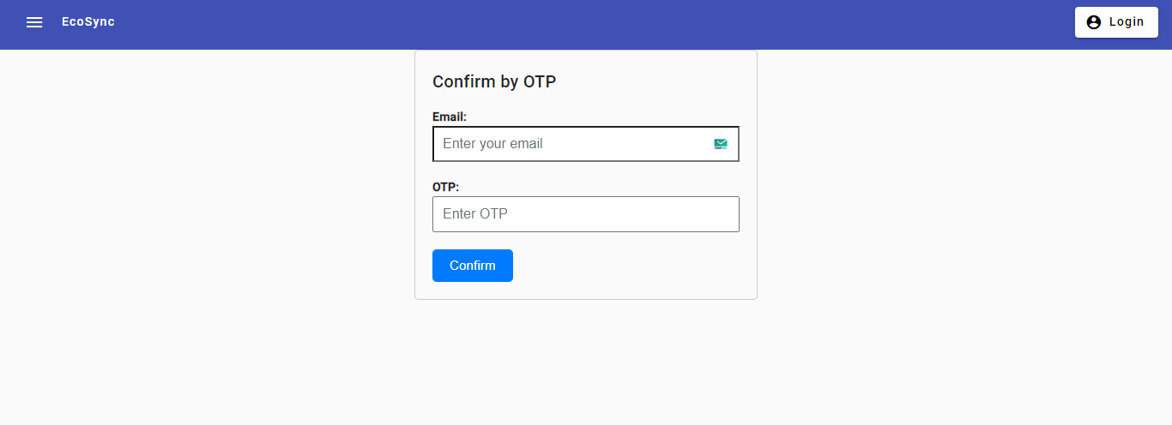
Confirm by OTP

Slide 11
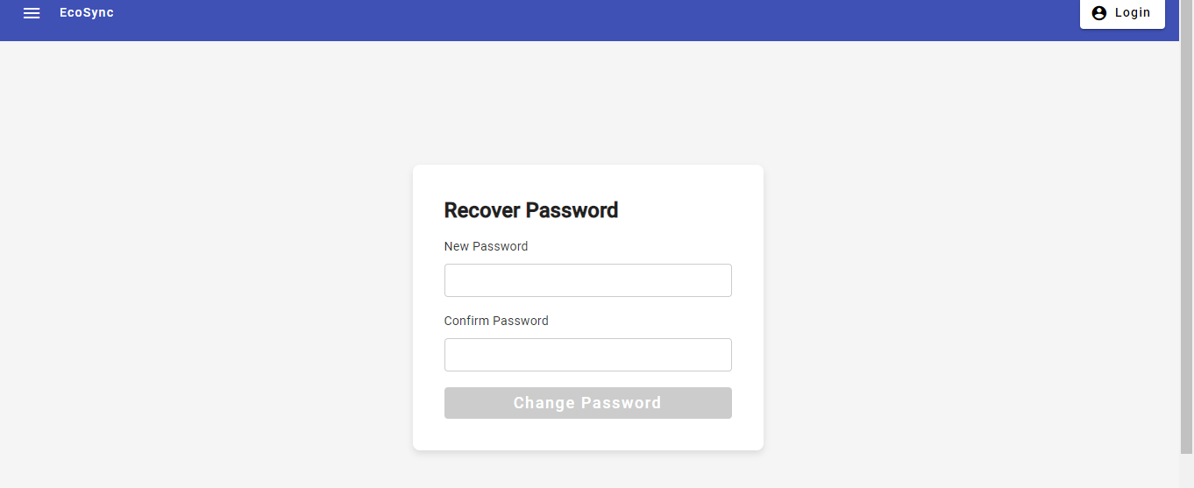
Recover Password

Slide 12
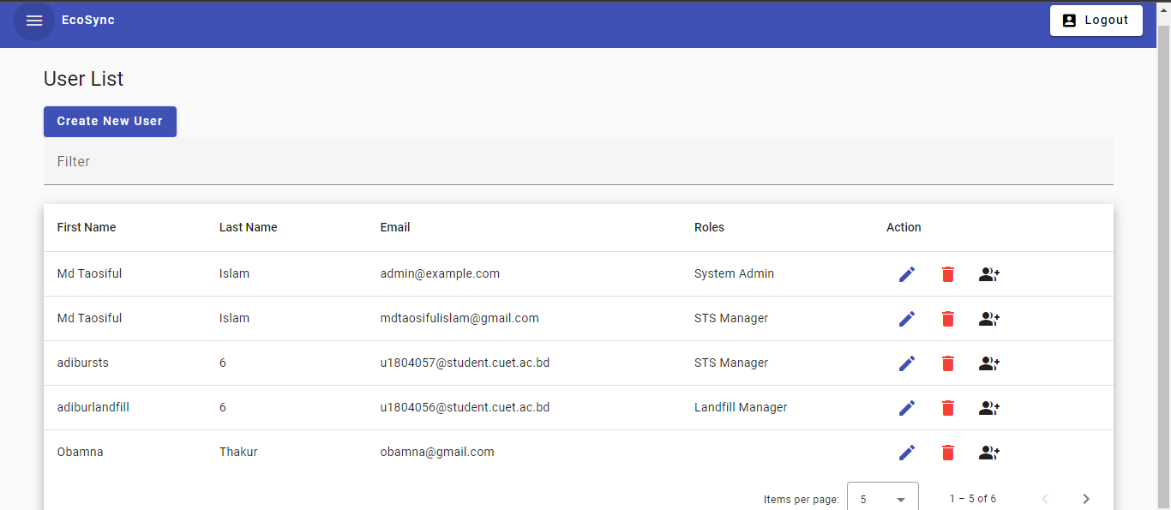
User List

Slide 13
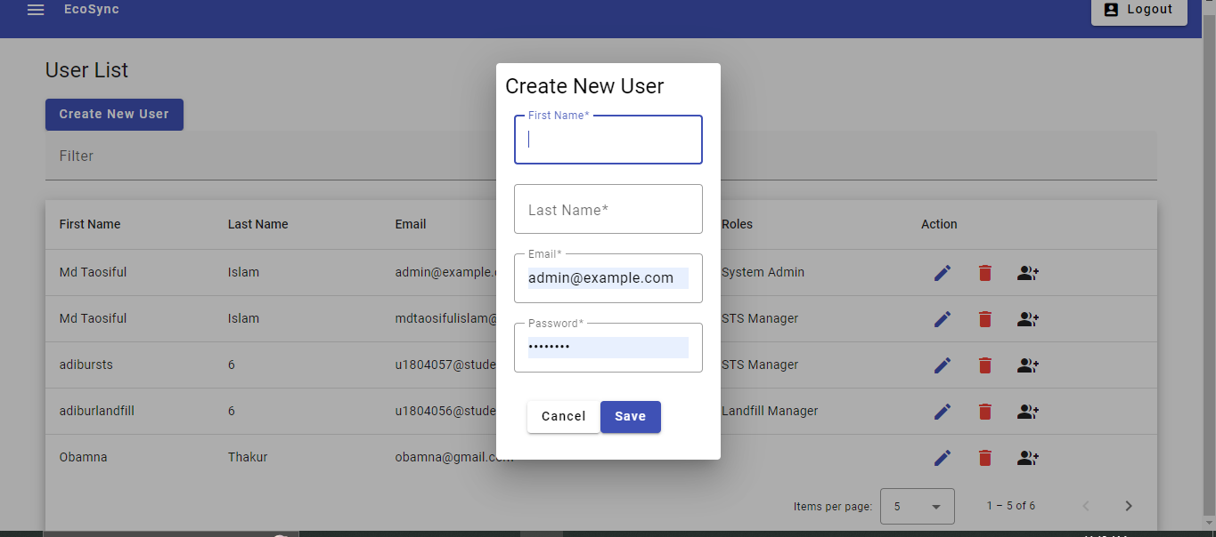
Create New User

Slide 14
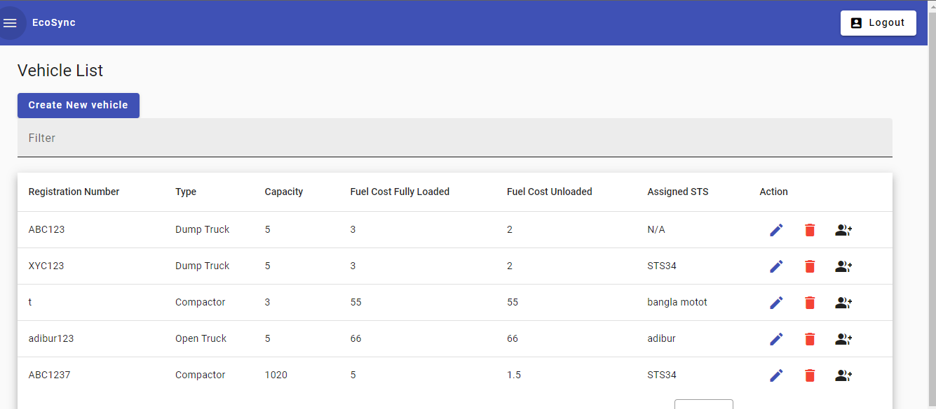
Vehicle List

Slide 15
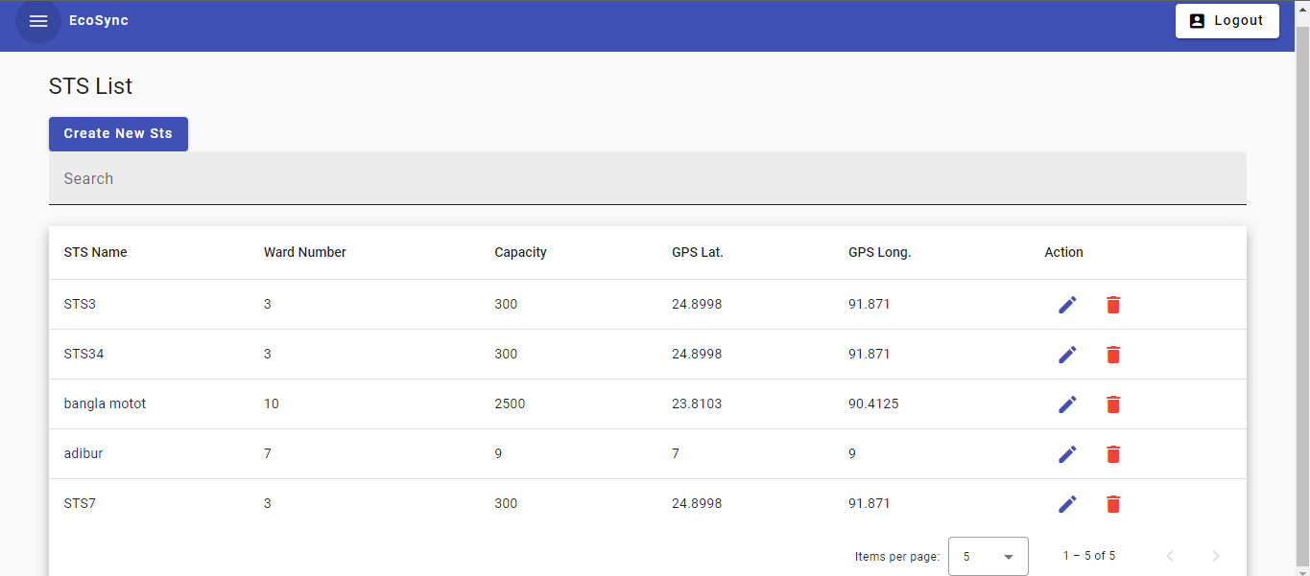
STS List

Slide 16
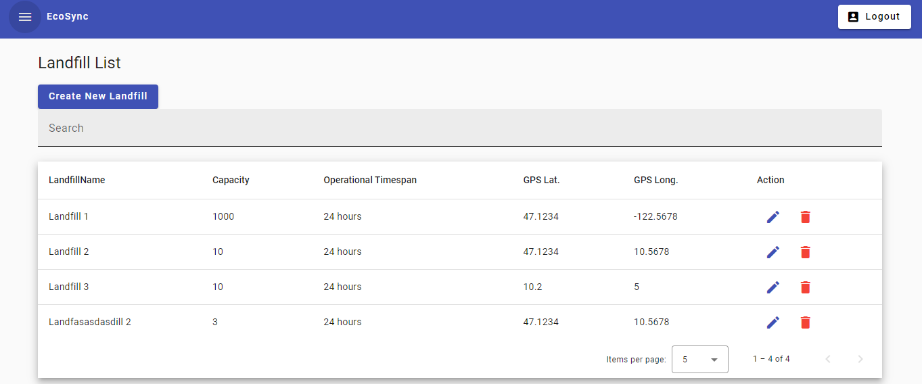
Landfill List

Slide 17
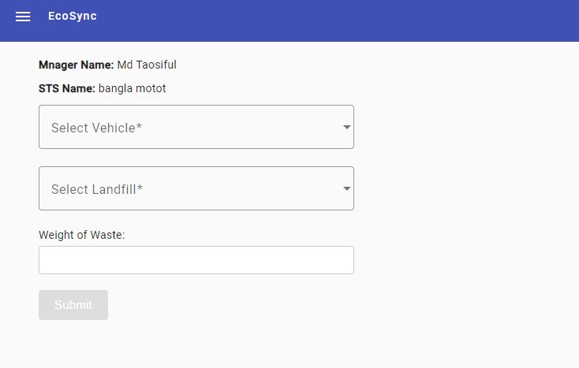
Starting vehicle by STS Manager

Slide 18
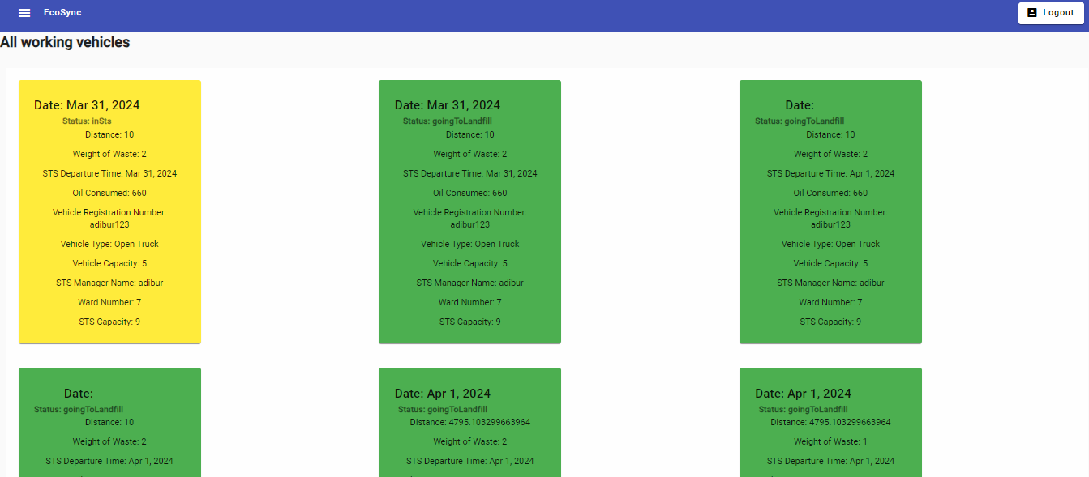
Waste Logs

Slide 19
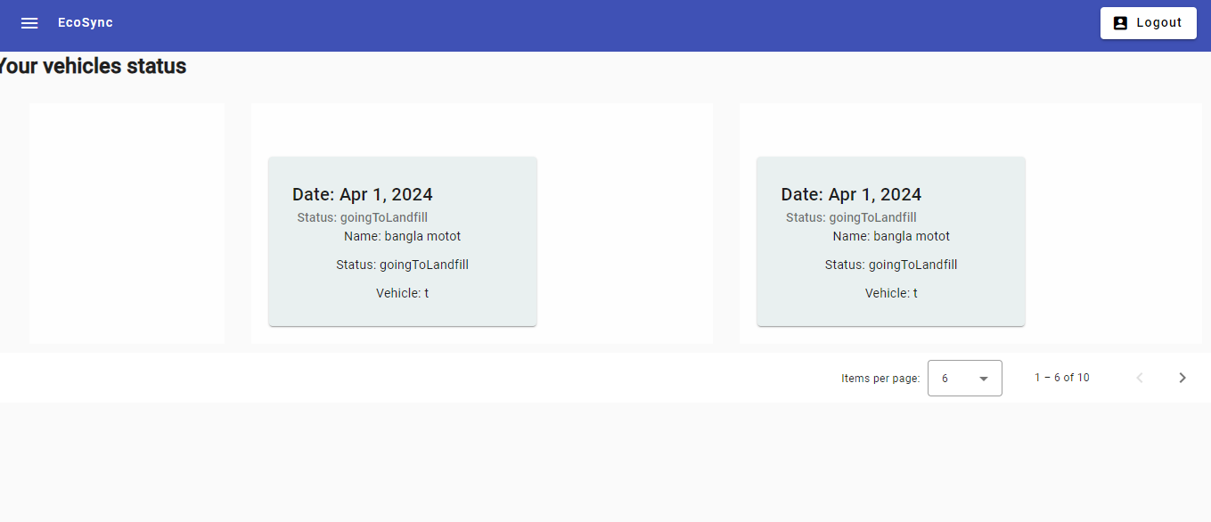
Show Vehicles to a STS Manager

Slide 20
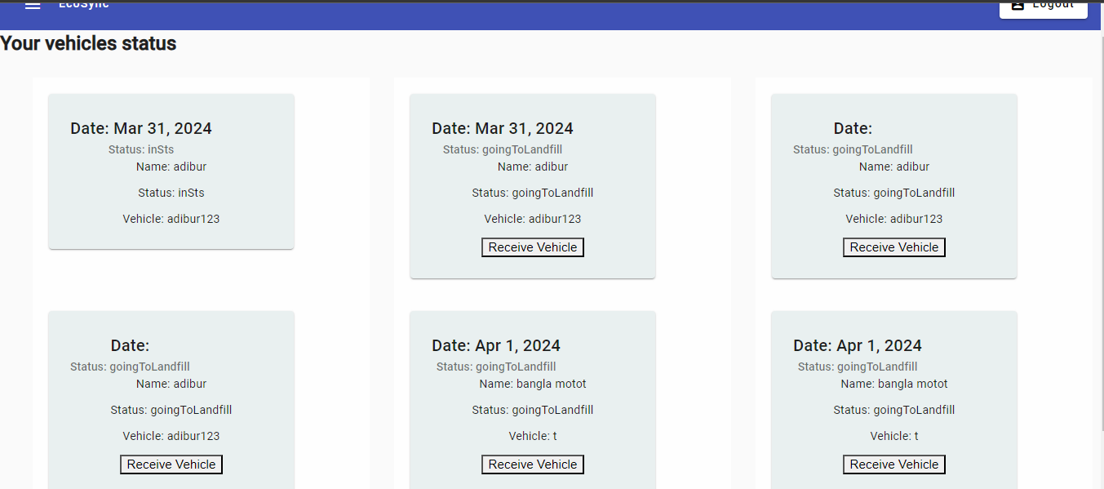
Show Vehicles to a Landfill Manager

